Slide 1
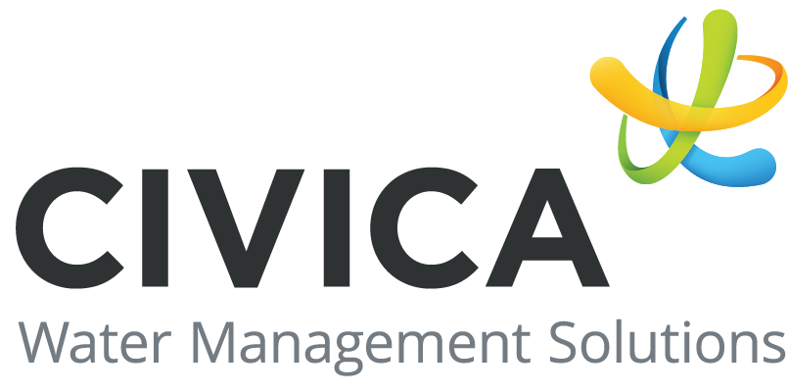
Public Information Centre – December 5th, 2023
Servicing Master Plan – Township of Severn
330 Rodinea Road, Unit 3
Vaughan, Ontario, Canada L6A 4P5
(905) 417-9792
www.civi.ca

Slide 2
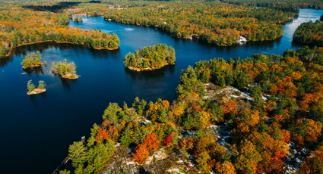
Introduction
Why do we need a Servicing Master Plan?
The Township of Severn is developing a Servicing Master Plan (SMP) to evaluate water, wastewater, and stormwater servicing strategies to accommodate growth for a 30-year planning horizon.
The Township’s total population is expected to grow from 14,576 in 2021 to approximately 23,280 by 2031. The SMP will focus on three primary settlements, five rural settlement areas, and two municipal drinking water systems.
Servicing refers to municipally provided services for:
Water distribution
Wastewater collection (sanitary servicing)
Stormwater management
What is Servicing?
The SMP Will Address the Following Scope:
An assessment of existing water, wastewater, and stormwater systems
Evaluation of growth area demands and reserve capacity impact
Provide recommendations on system upgrades and expansions
Provide project timing and cost estimates for the 30-year planning period

Slide 3
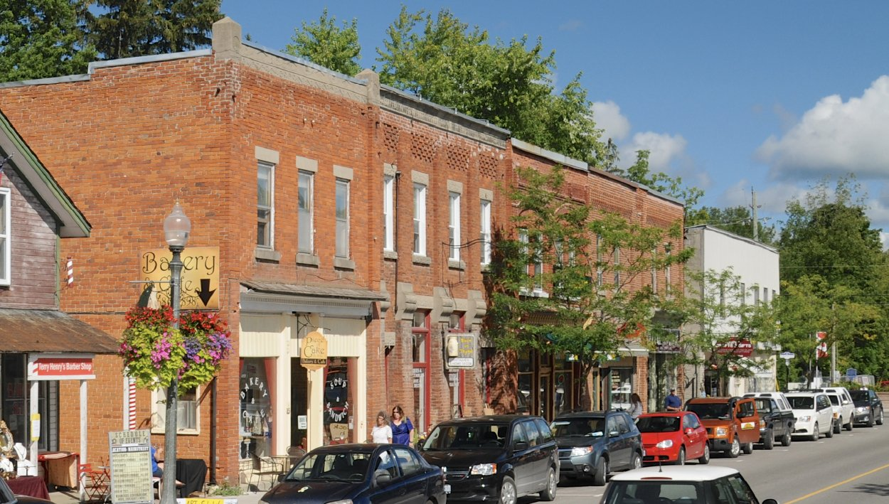
Problem and Opportunity Statement
The Problem and Opportunity Statement is defined as follows:
Following completion of the updated 2022 Official Plan, the Township has identified the intent to direct most forms of development to settlement areas where full water, wastewater, and stormwater services are planned or available. The Township of Severn’s total population is expected to grow from 14,576 in 2021 to approximately 23,280 by 2031, where the majority of the population will reside in the three main Settlement Areas and five rural Settlement Areas.
This presents the opportunity to identify and selected preferred alternative water supply and storage; wastewater collection and treatment; and stormwater management servicing strategies for the three primary settlements and five rural settlement areas that can accommodate growth for a planning horizon of 30-years, which minimizes impacts to both the natural and social environments and are both technically feasible and economically sensible.
How can the Township:
Identify existing capacity constraints
Evaluate different servicing alternatives
Provide solutions to accommodate the planned growth across the Township
Identified Opportunity
The Township at a Glance:
Three main settlement areas of Westshore, Coldwater, and Washago
Five rural settlements areas of Ardtrea, Fesserton, Marchmont, Severn falls, and Port Severn
Two municipal drinking water systems of Severn Estates and Sandcastle Estates
Servicing Master Plan Areas

Slide 4
Settlement Areas

Slide 5
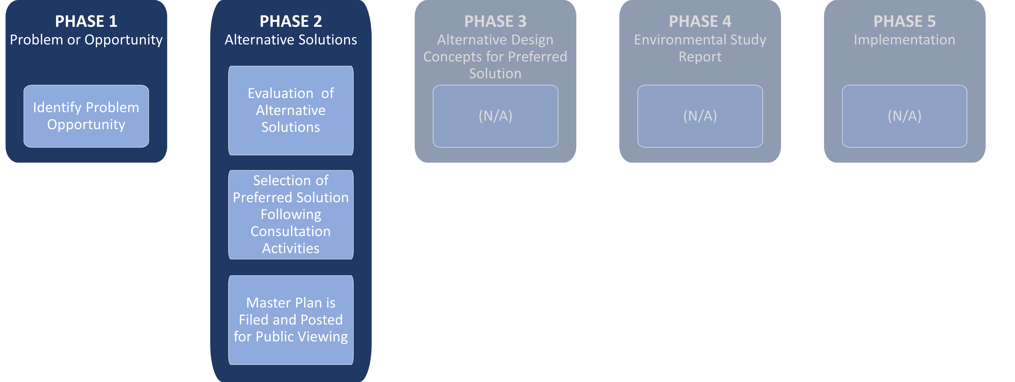
Environmental Assessment Process
Environmental Assessment (EA) Master Plan Process
The Municipal Class Environmental Assessment (MCEA) process was developed to provide municipalities with a risk-based approach to comply with the Environmental Assessment Act for both capital projects and infrastructure maintenance activities. The SMP study will be undertaken in conformance with the Municipal Class EA process. The Master Plan will address Phase 1 and Phase 2 of the Municipal Class EA.
The Class EA defines master plans as long-range plans which integrate infrastructure requirements for existing and future land use with environmental assessment planning principles. These plans examine an infrastructure system or group of related projects in order to outline a framework for planning for subsequent projects and/or developments.

Slide 6
PIC Objectives and Project Schedule
Introduce the SMP study to the public and obtain feedback from local residents, property owners, and community groups
Present existing conditions and areas of concern
Present the scope of the Class Environmental Assessment (EA) process
Introduce members of the project team
Project Schedule Timeline
Phase 1
Identify and Describe the Problem/Opportunity Statement
PIC #1
Public Consultation
December 5, 2023
Phase 2
Complete Study Area Inventory
Identify and Evaluate Alternative Solutions
PIC #2
Public Consultation
TBD
Final Report
Documentation of Recommended Alternative Solutions for Servicing
Council Presentation
TBD
Notice of Completion
TBD
We Are Here

Slide 7
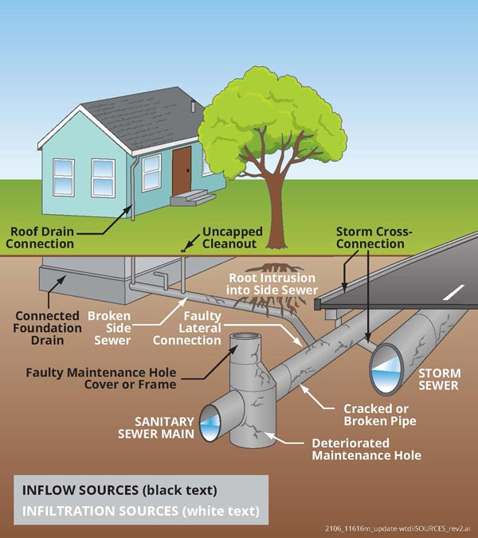
Wastewater System Terminology
Wastewater (Sanitary) Terms and Definitions:
Sanitary Sewer System: Underground pipe network used for transporting sewage and wastewater from houses and commercial buildings to a wastewater treatment plant or disposal facility.
Wastewater Treatment Plant: Removes contaminants from the wastewater to produce an effluent that is suitable to discharge to the surrounding environment or an intended reuse application.
Trunk Sewer: One of the main sewer lines in the wastewater collection system. They are large sewers that are used to convey wastewater from main sewers to treatment or other disposal facilities, or to large intercepting sewers.
Pumping Station: Receives and temporarily holds the wastewater that flows by gravity through pipes, then uses pressurized force to pump and send the wastewater up and out to continue its journey towards the wastewater treatment plant.
What is Inflow and Infiltration (I&I)?
Groundwater and stormwater that enters the sanitary sewer system through cross connections with the stormwater system or through cracks and other imperfections within the sanitary system.
Peak inflow can occur during heavy storm events when storm sewer systems are surcharged, resulting in hydraulic backups and pooling of water.
Reduces the capacity of the sewage system, leaving less for existing residents and future growth
Makes sewage treatment less efficient since the sewage is diluted by water
Increases the cost of sanitary sewer services to residents because sewage treatment plants are required to treat a higher flow volume
May cause sewage overflows or overwhelm treatment plants leading to health risks and property and environmental damage.

Slide 8
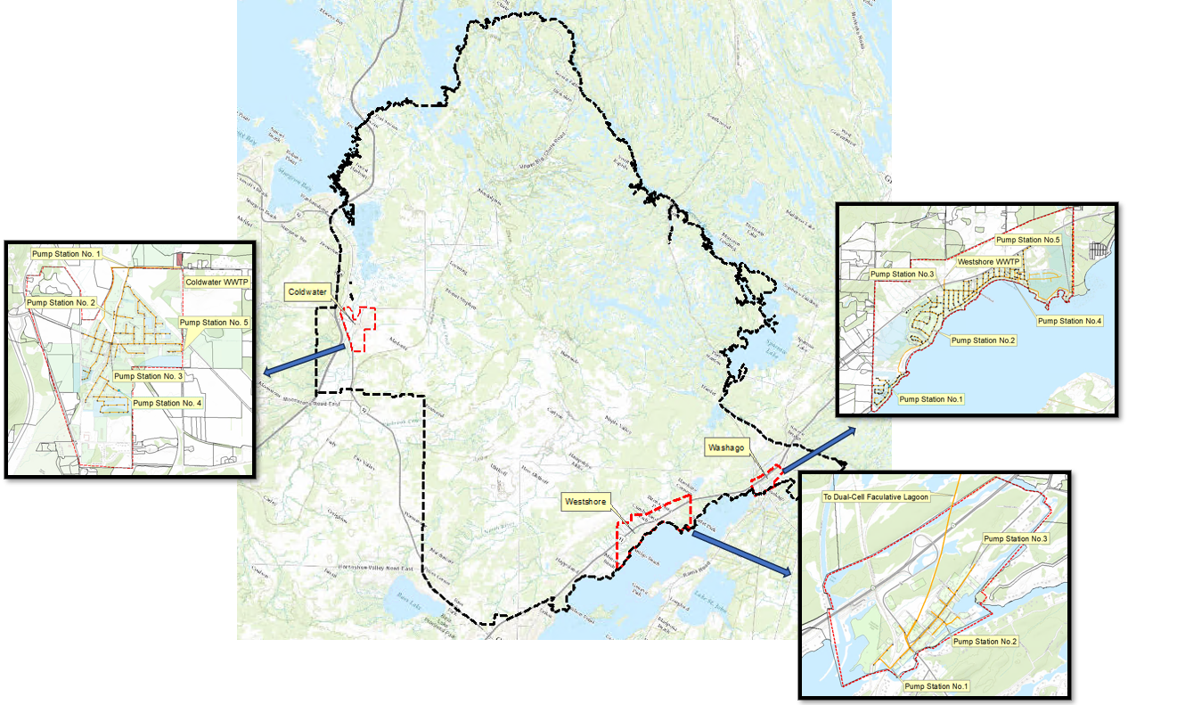
Study Area – Wastewater System
Current Levels of Wastewater Service in Severn:
Wastewater Service
Fully serviced settlement areas
Coldwater
Washago
Westshore
Private Systems (No Service)
Wells and Septic Systems or Other
Ardtrea
Fesserton
Port Severn
Severn Falls
Marchmont

Slide 9
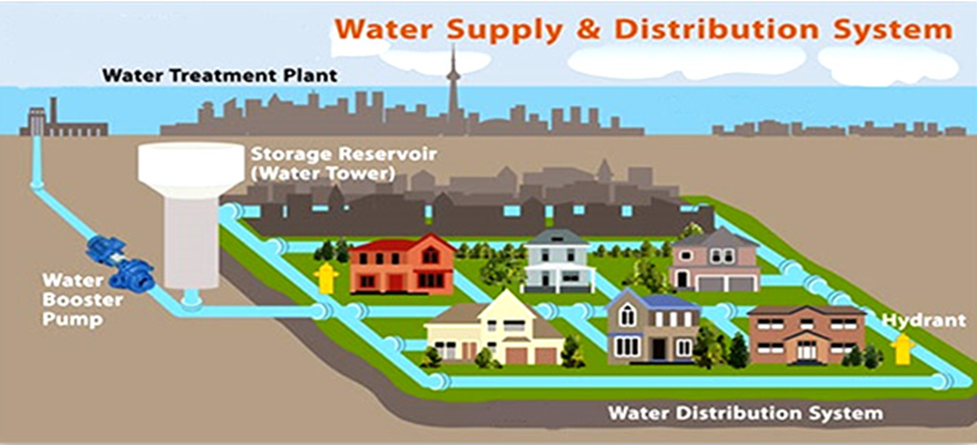
Water System Terminology
Water System Terms and Definitions:
Water Distribution System: Provides safe and high-quality drinking water for the Service Area, while having the capacity to deliver sufficient water at the right pressure for firefighting purposes.
Water Treatment Plant: Water goes through treatment processes to remove impurities, disinfect, and ensure it meets safety and quality standards. Treatment facilities can include filtration plants, chemical treatment units, and disinfection systems.
Water Source: Usually a natural water source, such as a river, lake, reservoir, groundwater well, or treatment plant, where water is collected and initially treated. Lakes and wells are water sources for the Severn distribution system.
Distribution Pipes: A vast network of pipes that transport water from treatment plants to consumers. These pipes are commonly constructed using materials such as cast iron, steel, PVC, or HDPE, ensuring safe and efficient water distribution. In Severn, most pipes are made of PVC.
Valves and Hydrants: Valves are used to control the flow of water within the distribution system, allowing for maintenance and repairs. Hydrants are used for accessing water in emergencies, such as firefighting.
Pressure Regulation Devices: Pressure-reducing valves (PRVs) are used to maintain consistent water pressure in the distribution system, ensuring adequate supply and preventing damage to pipes and appliances.

Slide 10
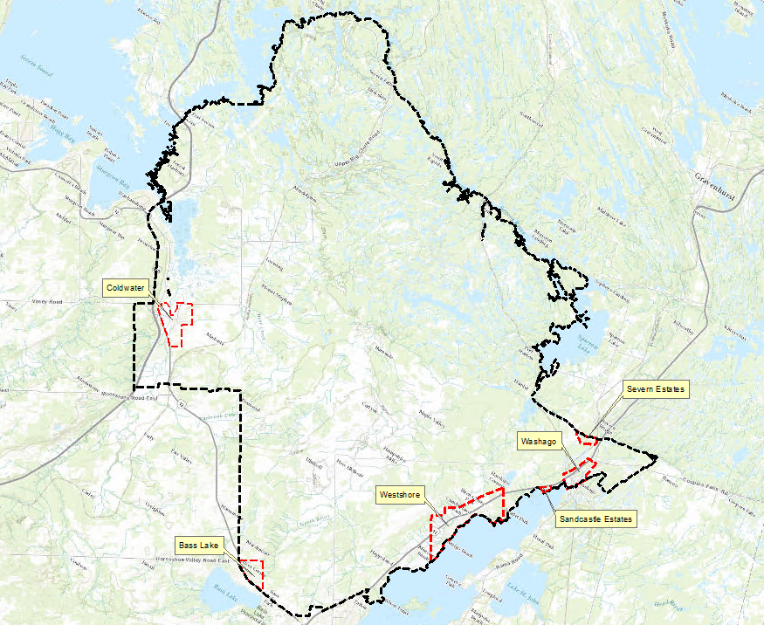
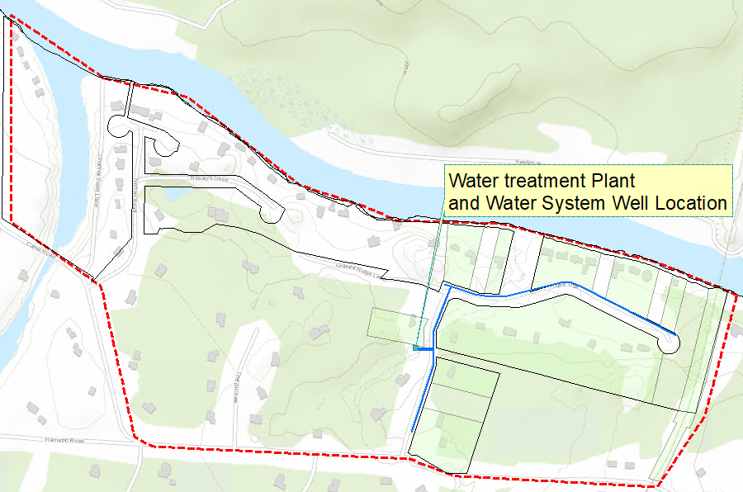
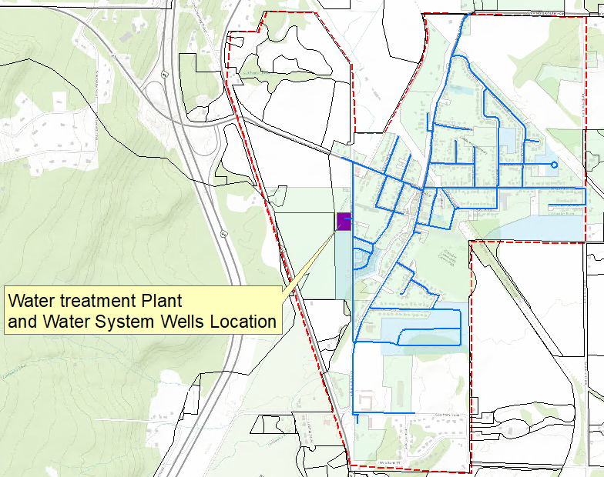
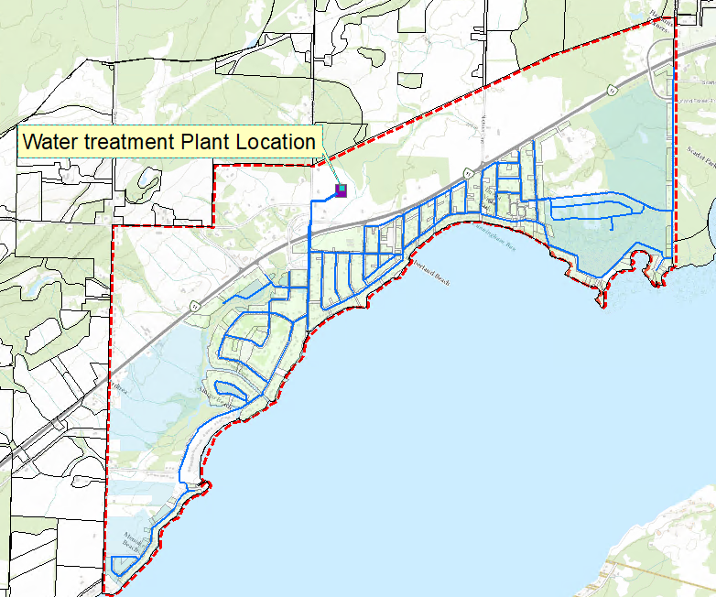
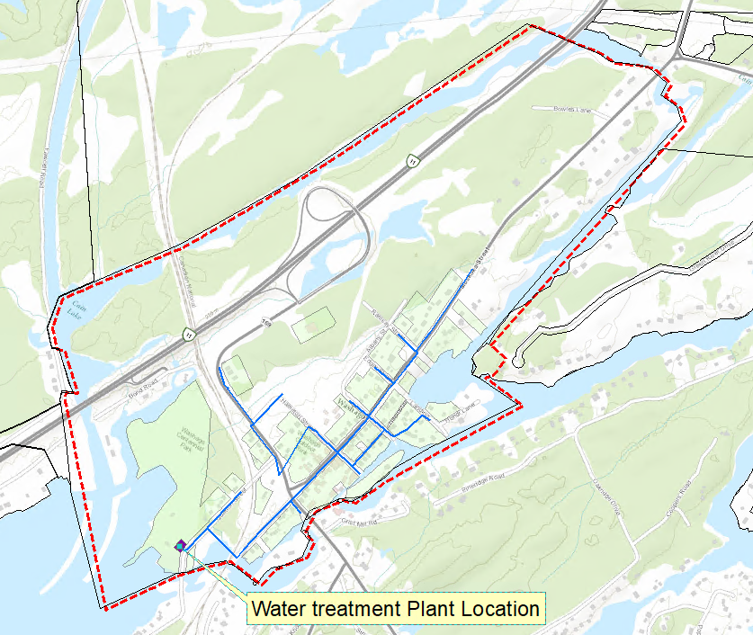
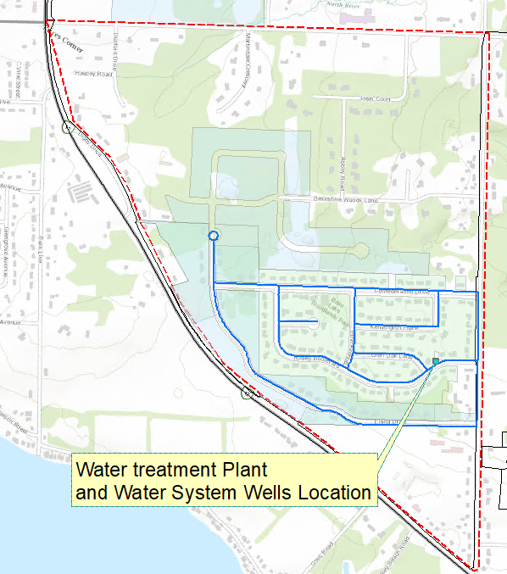
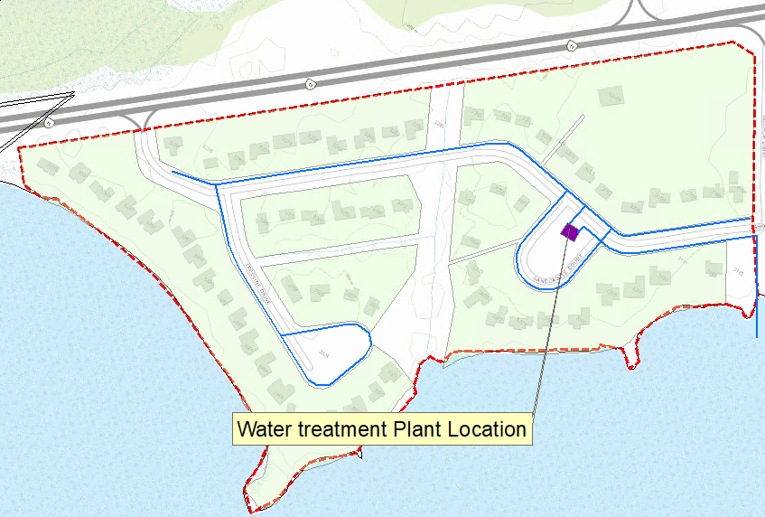
Study Area – Water System
Current Levels of Water Service in Severn:
Water Service
Fully serviced settlement areas
Coldwater
Washago
Westshore
Water Supply Service Only
Municipal Drinking Water Systems
Bass Lake Woodlands
Sandcastle Estates
Severn Estates
Private Systems (No Service)
Wells and Septic Systems or Other
Ardtrea
Fesserton
Port Severn
Severn Falls
Marchmont

Slide 11
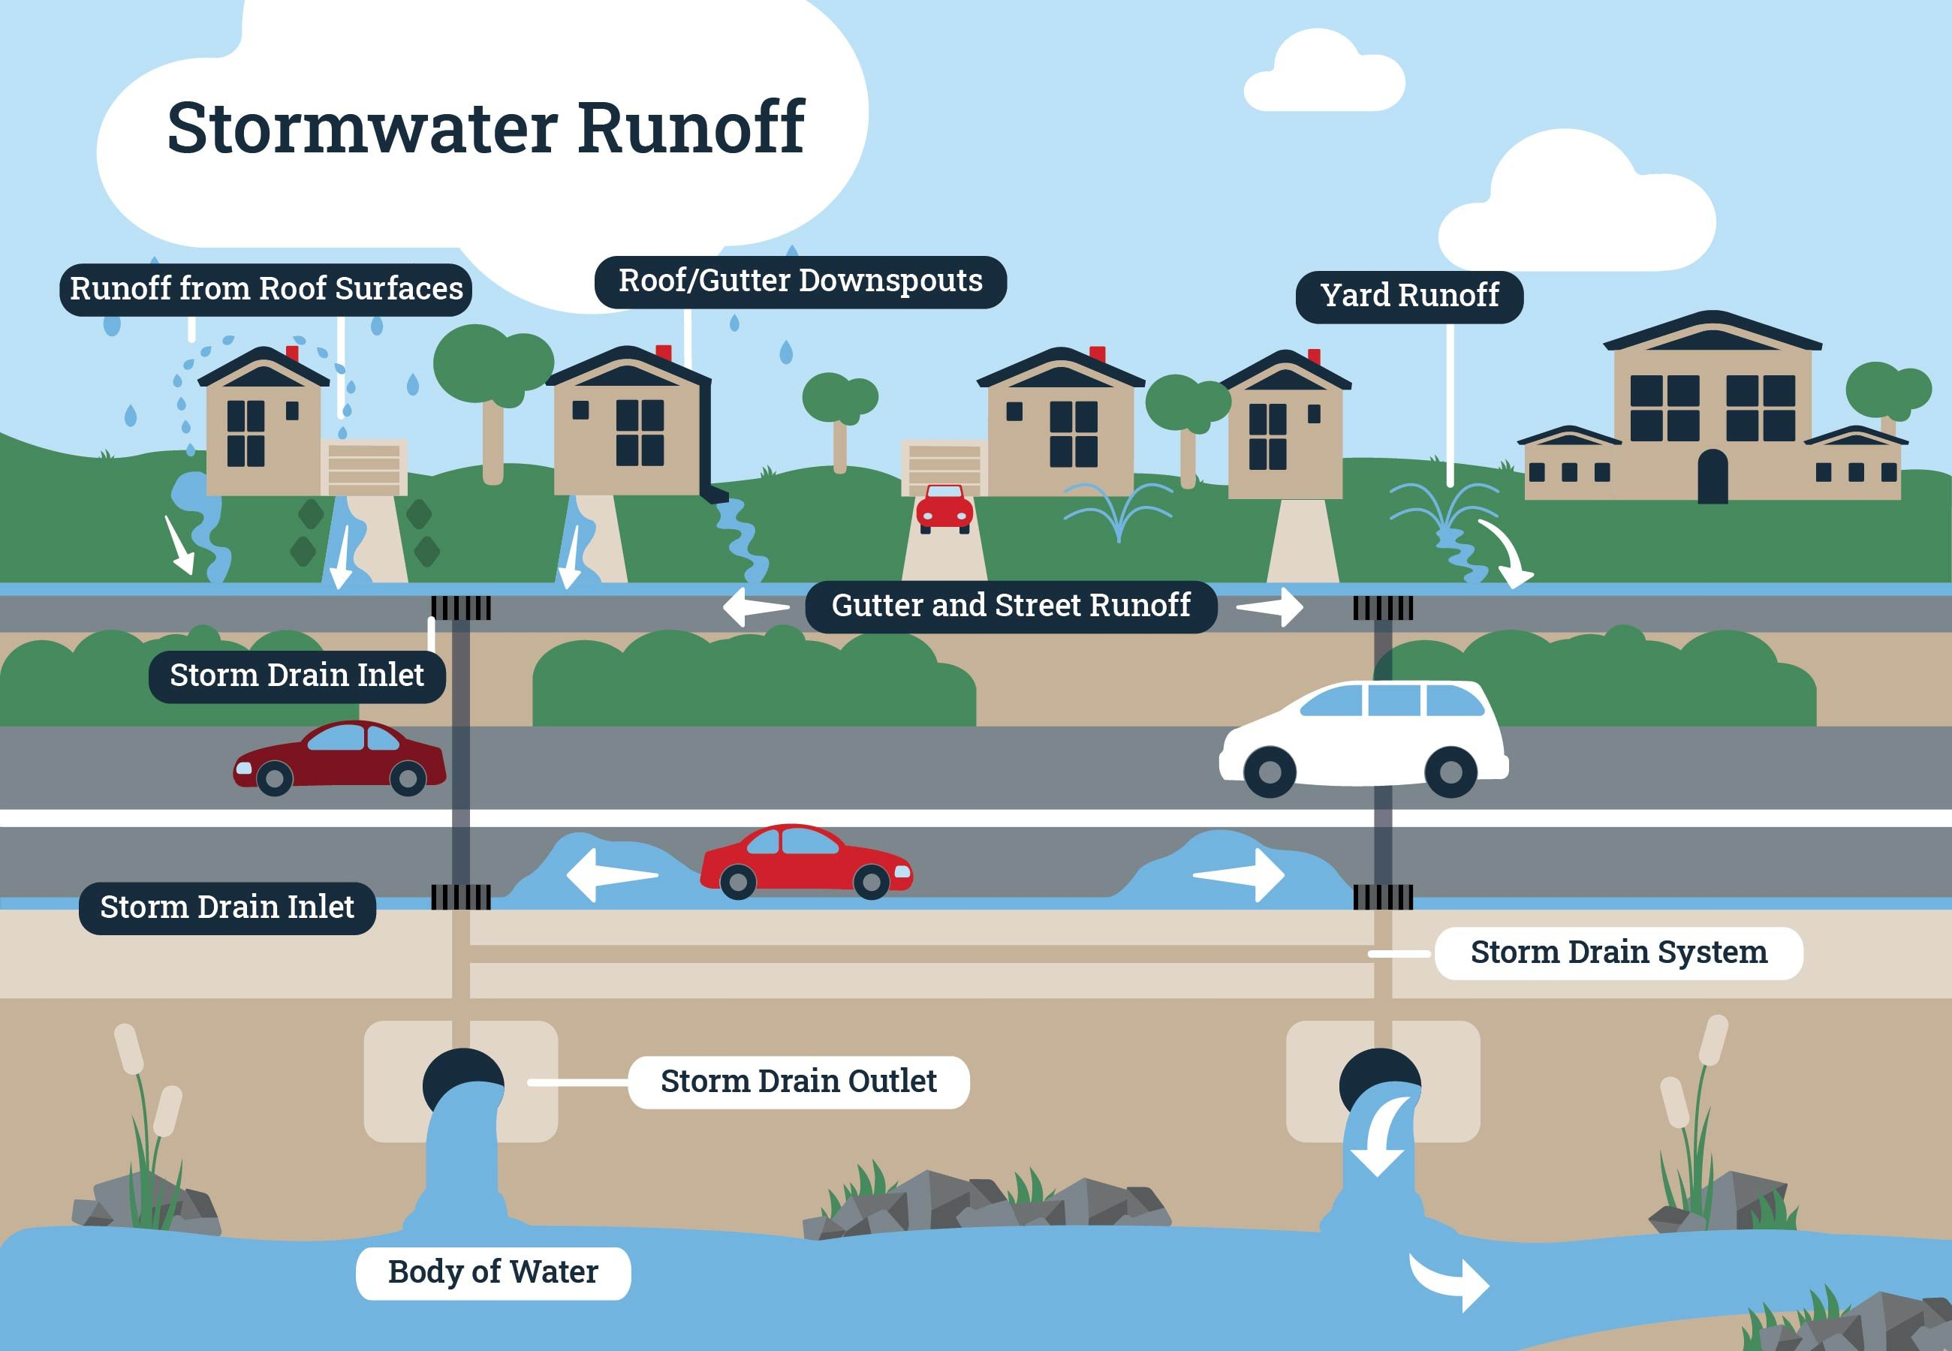
Stormwater Sewer System Terminology
What is Stormwater?
Stormwater is water that comes from rain and melted snow that flows over property and into the storm drains. Stormwater naturally soaks into the ground and becomes groundwater, during a process called infiltration. As Severn continues to develop, we create more paved and impermeable surfaces, such as driveways, parking lots, streets, and roofs – these surfaces can prevent stormwater from being absorbed into the ground. Along the way, the stormwater picks up debris and pollutants from rooftops and paved surfaces that then enter the storm drains and watercourses. The disruption to the natural hydrologic water cycle also means the stormwater runs off quickly into storm drains and sewer systems, and then to our lakes and rivers, which can lead to flooding, and other environmentally damaging effects.
Stormwater Terms and Definitions:
Stormwater: Rainwater that enters the stormwater drainage system and empties into rivers, lakes and streams.
Stormwater Drainage System: A network of underground pipes and open channels designed for flood control, which discharges straight to creeks and rivers.
Catch Basin: Curbside opening that collects rainwater from streets and serves as an entry point to the storm drain system.
Pond: A stormwater control structure into which storm runoff is directed. May be a dry pond (temporarily stores incoming stormwater) or a wet pond (permanent pool of water with additional capacity).
Outfall: Discharge point by which stormwater leaves the pipe system and enters the water system (i.e. creek, river).
Watershed: An area of land that drains water or runoff to a single point, usually a confluence of streams or rivers, can also be known as drainage area, catchments, or a river basin.

Slide 12
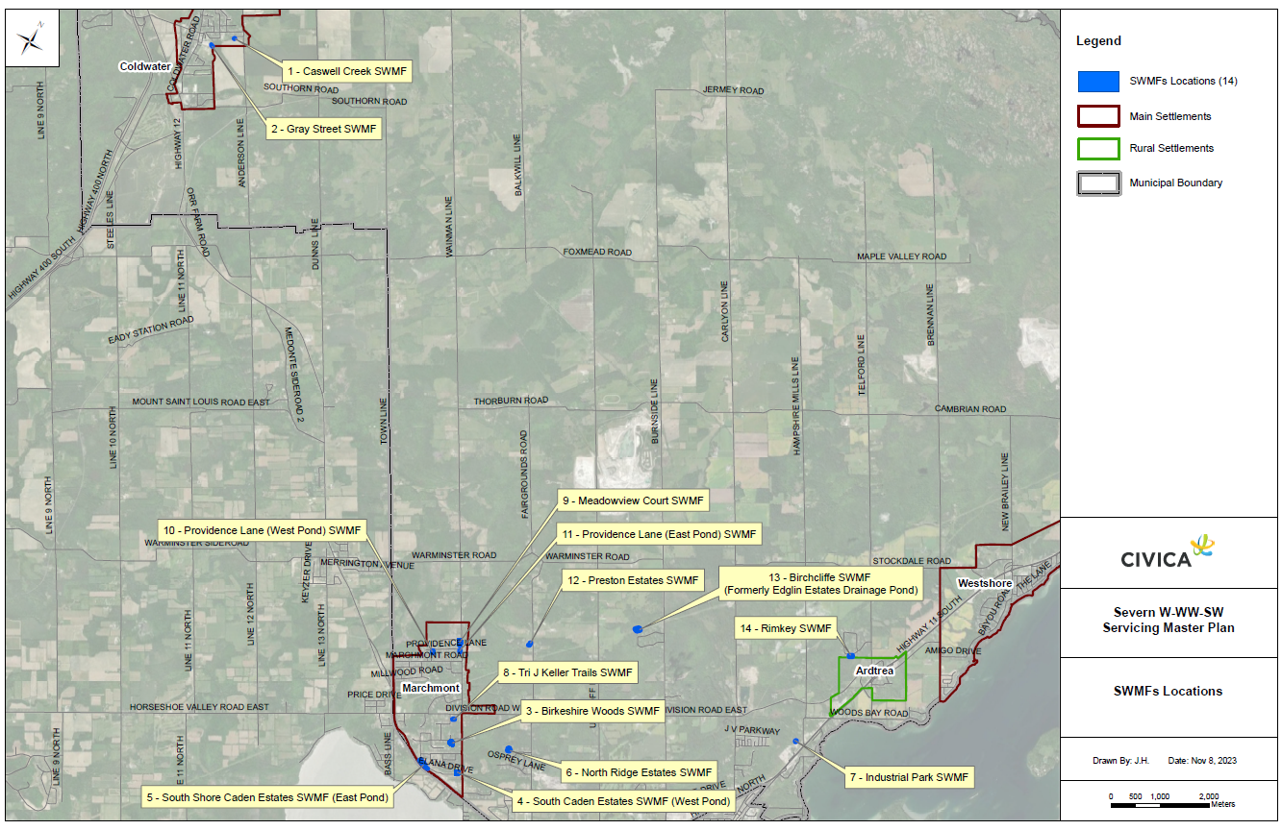
Study Area – Stormwater System
Current Levels of Stormwater Service in Severn:
400 km of Open Ditches, Catch Basins, and Manholes
7.9 km of Collection Storm Sewers
13 Stormwater Management Facilities

Slide 13
Project Objectives
Proposed Analysis Approach:
Determine a recommended servicing strategy that accommodates the expansion and growth of serviced areas and undeveloped lands in the study area for the 30-year planning horizon.
Assess and review current infrastructure conditions and performance, including the associated costs with operational expansions and any new capital projects that may be required.
Employ current standards to determine system hydraulics and capacities for water treatment and distribution, wastewater treatment, and collection areas.
Evaluate potential impacts of inflow and infiltration (I&I) in the wastewater collection systems and make recommendations for future monitoring.
Calculate GHG inventories and GHG reduction targets specifically pertaining to the municipal water, wastewater, and stormwater services, to satisfy the Township’s requirements.
Proposed Analysis Approach

Slide 14
Alternative Solutions:
Do Nothing
Demand Management
Capacity Optimization (I&I reduction, leak detection in water)
Asset Expansions/Additions
Proposed Alternatives
Evaluation Criteria: What Key Issues Will be Addressed?
Technical & Operational
Financial
Potential impacts to existing natural environment
Protecting wildlife and species at risk
Able to meet existing and future demands
Aligns with existing and planned infrastructure
Ease of construction and integration with existing system
Capital planning and life cycle costing
Stakeholder input
Environmental
Societal & Cultural

Slide 15
Next Steps
Following Public Information Centre #1, we will:
Share the SMP
Review public feedback to better understand the priorities of Township of Severn residents and stakeholders
Outline the servicing system needs, issues, and opportunities, building on your input
Develop recommended infrastructure projects and supporting policies and strategies
Present recommended projects, strategies and other solutions at the second round of public consultation, expected to take place in Spring 2024
Provide your feedback on the SMP objectives, your thoughts on sanitary and stormwater system issues, and your suggestions on where we can best focus infrastructure improvements in the Township of Severn.
Help shape the SMP study by visiting Severn.ca/servicingplan to:
Submit questions or comments to the project team
See the latest updates and future public consultation opportunities
Who’s Listening?
Derek Burke
Director of Public Works
Township of Severn
705-325-2315 ext. 230
dburke@severn.ca
Ilmar Simanovskis, P.Eng
Consultant Project Manager
Civica Infrastructure Inc.
905-505-5080
isimanovskis@civi.ca

